Slide 1
Nature of Social Responsibility of Business

Slide 2
Learning Objectives
By the end of this session, you will be able to:
Understand the Nature of Social Responsibility of Business.

Slide 3
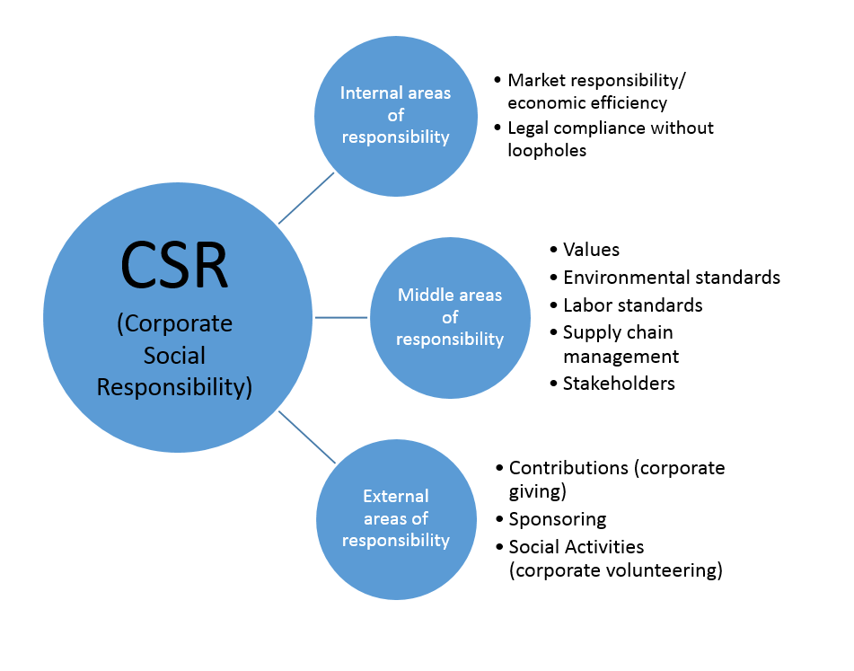
Nature of Social Responsibility of Business

Slide 4
Nature of Social Responsibility of Business
Corporate social responsibility is a somewhat unclear concept, and consequently there are several ways of understanding the underlying concept. A relatively popular model is the responsibility model mapped out by Stefanie Hiss. She separates CSR into three core areas, which are each named according to the nature of their work:
The internal area of responsibility encompasses all internal strategies and processes that do not reach the public but which are essential for the ethical orientation of the company.
The middle area of responsibility includes all of the fields that are publicly effective and have a direct effect on the environment and society, but which are still a normal part of the working process.
The external area of responsibility is for all activities that require action; for instance, if a company becomes charitably active (mostly financially) and interrupts or adapts its daily work processes.

Slide 5
Nature of Social Responsibility of Business
1. Internal responsibility
The internal area of responsibility includes all internal processes that affect the corporate strategy itself. The internal area of responsibility is usually the responsibility of company executives and influences important decisions, e.g. which business partners are acquired, one's own responsibility to the market with regard to monopolies, fair and realistic growth planning, and healthy profitability.
In the ideal case, the moral compass of the company plays an important role in decision-making, however, it is usually difficult to judge from the outside to what extent a company takes its internal area of responsibility seriously. CSR management that is visible to the outside world is at least an indication that the internal strategy also takes moral principles into account.

Slide 6
Nature of Social Responsibility of Business
2. Middle area of responsibility
The middle area of responsibility includes all those actions of a company whose effects on the environment and society can be measured more or less directly. This includes CO2 emissions and air pollution as well as working conditions for employees. This also includes responsible supply chain management, because cooperation with morally questionable companies ultimately supports their corporate policy.
Corporate social responsibility (CSR) in the middle area of responsibility is the most difficult to coordinate for many large corporations, but has gained considerable importance – precisely because it is in this area that the most damage can occur. This applies not only to the environment and society, but also to a company’s own employees, stakeholders, and reputation.

Slide 7
Nature of Social Responsibility of Business
Stakeholders:
Stefanie Hiss suggests that the middle area of responsibility mainly refers to stakeholders. Generally speaking, stakeholders are people who have an increased interest in processes, working conditions and, in most cases, the success of the company. The following groups of people form important stakeholders:
Employees:
Companies have a duty to their employees to ensure a pleasant working environment and, in addition, to make information sufficiently transparent in terms of career opportunities and hierarchies. This also includes the issue of fair payment and profit sharing as well as the limitation of the term of contracts.

Slide 8
Nature of Social Responsibility of Business
Another fundamental element for healthy CSR in this area is the constructive interaction with trade unions when they operate within the company. In extreme cases, there can be strikes if companies do not take their social responsibility towards their employees seriously. Unacceptable working conditions sometimes even call human rights organizations or state institutions into question. Frequently employees will make these grievances public, meaning that the news can spread like wildfire across social media and cause considerable image damage.
Equity and debt capital providers
Investors have a clear interest not only in the success of the company, but also in fair cooperation. Above all, listed companies are threatened with considerable damage if their dealings with business partners and investors are morally questionable or dishonest.

Slide 9
Nature of Social Responsibility of Business
Clients:
Companies that supply products should not deceive their customers. Especially in the case of consumer goods such as food, a company has the responsibility to correctly inform the customer about the preparation and composition of the product. Knowing the origin of the product and the raw materials used is also important to many customers. If a company presents itself to the outside world as environmentally friendly, but uses eggs from caged production or components from environmentally harmful production plants in the manufacturing of a product, this can lead to the loss of a considerable customer base.
For many companies, the customer is by far the most important stakeholder. If a company does not take its social responsibility towards its customers seriously, this is often due to poor CSR management (if any).

Slide 10
Nature of Social Responsibility of Business
Local residents:
Companies located in cities or at least in the immediate vicinity of settlements also have a responsibility towards local residents. The operation should not have a negative impact on the quality of life of the residents. This applies, for example, to noise and environmental pollution. In many countries, people still suffer from the harsh living conditions as large factories ignore their social responsibility.
In the worst case, companies cause drinking water pollution, unacceptable noise, air pollution, and damage to the surrounding flora and fauna. If such injustices are made public, the company is threatened not only with damage to its image, but also problems with the law and environmental protection organizations.

Slide 11
Nature of Social Responsibility of Business
Governmental agencies
Companies must comply with the laws of the countries they operate within. This also includes smooth and honest cooperation with government organizations such as, for example, health and safety departments and health offices. In production facilities, the quality standards and regulations specified by the legislator must be observed through regular checks and surveys.
Media
The responsibility of the "fourth estate" includes the most complete possible reporting of grievances in companies. The relationship between journalists and business is therefore often two-sided: on the one hand, a company wants to present itself as well as possible, so that the media can help cultivate a positive image of them through their reporting. On the other hand, companies that do not live up to their corporate responsibilities can quickly suffer damage to their image if journalists speak out about it. Media representatives are therefore not welcome on some company premises.

Slide 12
Nature of Social Responsibility of Business
3. External area of responsibility
As part of their corporate social responsibility, many companies not only concentrate on internal processes, but also assume social responsibility outside their own operations. The external area of responsibility is often equated with the term "corporate citizenship", and these are some examples of what it constitutes:
Contributions
Corporate giving is the most popular means of actively living corporate responsibility. Frequently, however, these donations are also linked to the sale of goods and are thus intended to promote higher sales figures: for example, by promising to donate part of the profit per product sold to a good cause. Many companies also participate in events such as marathons and fundraisers, where employees can participate. Of course, all this brings good publicity to the companies, but it does not diminish the general benefit of these actions. Such charity events are ultimately profitable for all concerned.

Slide 13
Nature of Social Responsibility of Business
Sponsoring
Companies often also fulfill their social responsibility by sponsoring special initiatives or supporting associations that pursue charitable goals. In return, the companies are positively mentioned by these institutions and benefit from being associated with them. Often, this helps companies improve their reputation with local residents – for example, by sponsoring city projects and regional events.
Social activities
Companies are often willing to give employees time off if they want to carry out social activities. Alternatively, paid time for charitable work is regulated in employment contracts: for example, where employees are granted half a working day per quarter for these activities. Many companies are therefore prepared to support and even reward the social contributions of their employees by recording these activities as working time.

Slide 14
Topic Review
In this session, we have discussed about
the Nature of Social Responsibility of Business

